Slide 1
Economic Analysis and Decision-Making Tool
for Software Projects
YE Yvain/MARTIN Clément/陈嘉祺/周佳楠
2025/6/13

Slide 2
Project Overview
01
目录
Tech Stack
02
CONTENTS
Project Details
03
Project Display
04

Slide 3
Project Overview
01
01

Slide 4
Project Overview
An interactive economic analysis tool
support decision-making in software projects
evaluate costs, budgets, risks, and resource allocation throughout the Software Development Life Cycle
01
Notes:
our aim is to make an interactive economic analysis tool to support... by evaluating...

Slide 5
Tech Stack
02
01

Slide 6





Tech Stack
Frontend
Backend
DataBase
01
Notes:
The back-end technology stack is

Slide 7
Project Details
03
01

Slide 8
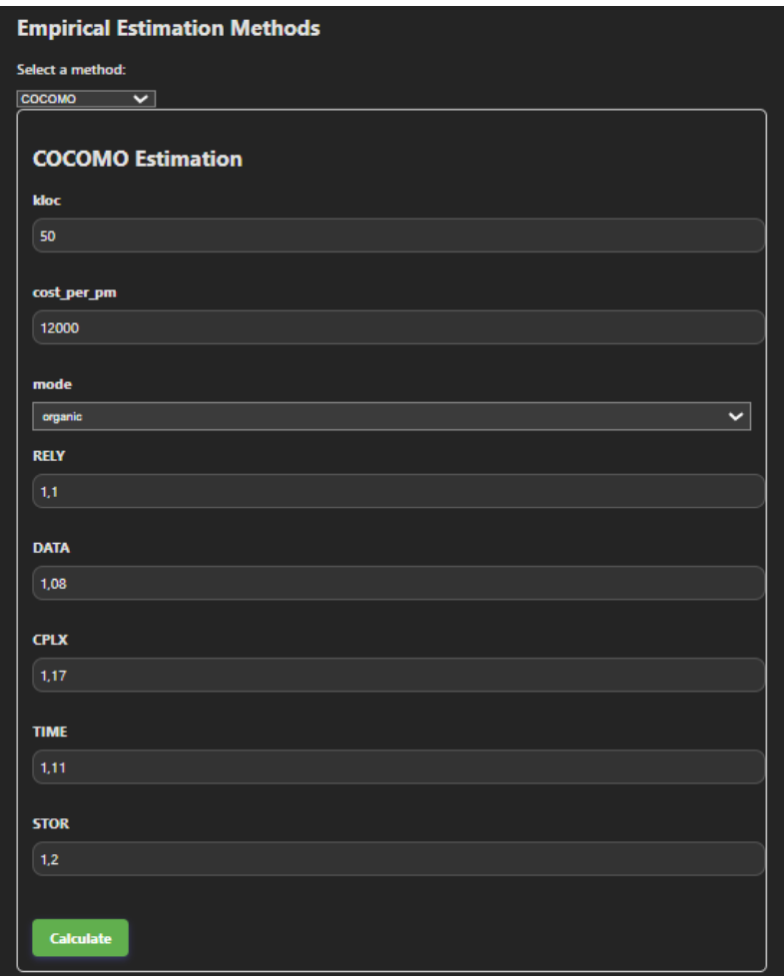
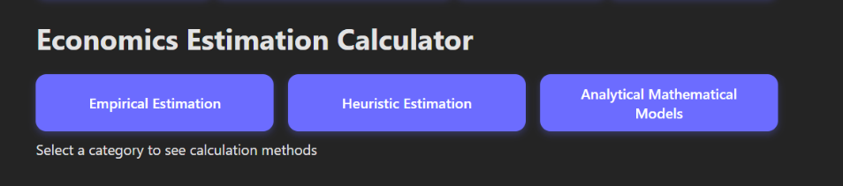
CostEstimation
COCOMO / Function Points
2
Implement multiple cost estimation techniques
3
organic / semi-detached / embedded
1
Expert Judgment / Delphi Method
Regression Analysis
The estimation of cocomo(organic) can be carried out according to the above steps.You can also scroll down to select other methods.
01
Function:
Estimate the workload, time, team size and total cost of the project
Notes:
使用 COCOMO 基本模型估算项目的工作量、时间、团队规模和总成本
Estimate the workload, time, team size and total cost of the project using the COCOMO basic model

Slide 9

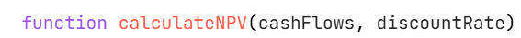
Budgeting
The initial guessed IRR value
01
We defined these functions to calculate economic metrics to manage project budgets.

Slide 10
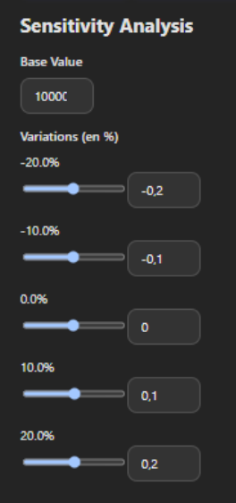
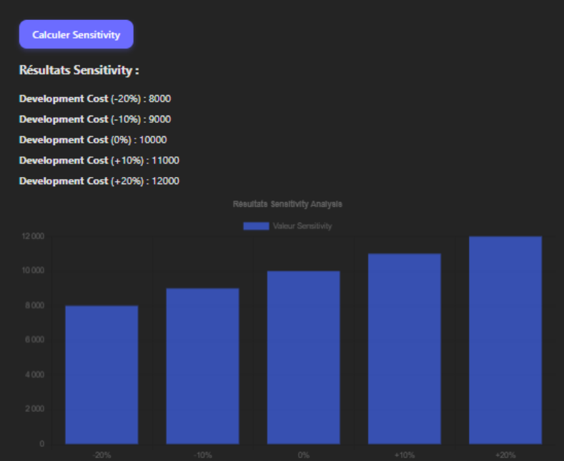
Risk Management
Function:
Identify key risk factors
help the team focus on highly sensitive factors
01
Notes:
实现敏感性分析功能，允许用户输入基础值和多个变化率，然后通过 API 请求计算敏感性分析结果，并使用 react-chartjs-2 库将结果以柱状图的形式展示。
The sensitivity analysis function is implemented, allowing users to input base values and multiple rates of change. Then, the sensitivity analysis results are calculated through API requests, and the results are displayed in the form of bar charts using the react-chartjs-2 library.

Slide 11
Risk Management
The user inputs the results of different options along with their probabilities and values, and then calculates the expected value of each option through an API request.
01
Function:
Choose the strategy with the least risk

Slide 12
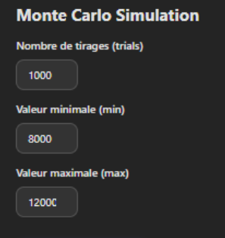
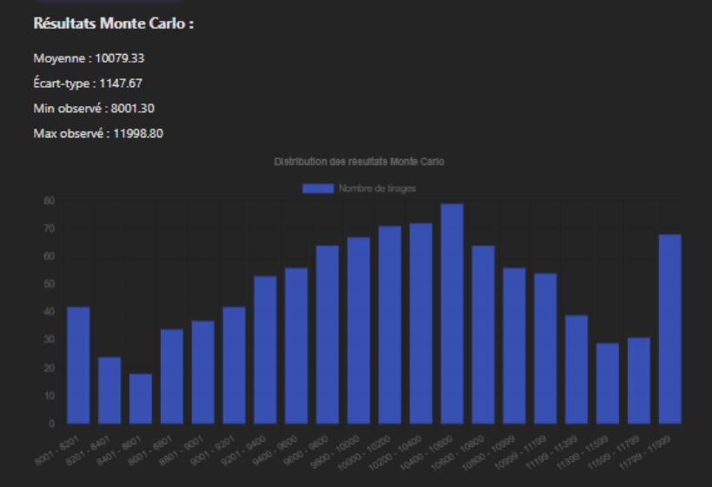
Risk Management
Function:
Provide a global risk probability view
01
Notes:
实现蒙特卡罗模拟功能，允许用户输入模拟次数、最小值和最大值，然后通过 API 请求进行蒙特卡罗模拟，并使用 react-chartjs-2 库将模拟结果的分布以柱状图的形式展示。
The Monte Carlo simulation function is implemented, allowing users to input the number of simulations, the minimum value and the maximum value. Then, Monte Carlo simulations are conducted through API requests, and the distribution of the simulation results is displayed in the form of a bar chart using the react-chartjs-2 library.

Slide 13
Resource Allocation & Optimization
Allocate resources for tasks to ensure that the usage of each resource does not exceed its limit on any given day.
When the duration of the task is fixed, allocate resources as evenly as possible.
01
Analyze different project scenarios and calculate the total workload, total duration and average daily workload of each scenario.
Notes:
对任务进行资源调配，确保每个资源在任何一天的使用量都不超过其限制
Allocate resources for tasks to ensure that the usage of each resource does not exceed its limit on any given day
在任务持续时间固定的情况下，尽可能均匀地分配资源。
When the duration of the task is fixed, allocate resources as evenly as possible.
对不同的项目情景进行分析，计算每个情景的总工作量、总持续时间和平均每日工作量。
Analyze different project scenarios and calculate the total workload, total duration and average daily workload of each scenario.

Slide 14
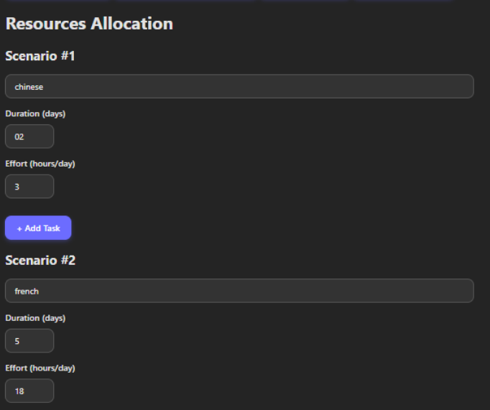
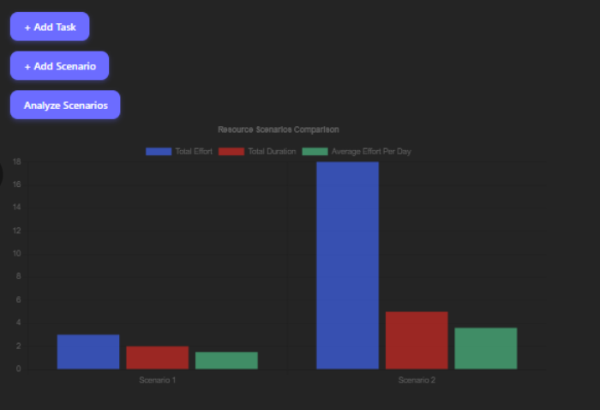
Resource Allocation & Optimization
01
you can add a task or scenario
each scenario object contains a task attribute, each task object contains effort and duration

Slide 15
Project Display
04
01

Slide 16
Thanks!
YE Yvain/MARTIN Clément/陈嘉祺/周佳楠
2025/6/13

